Slide 1



Keeping safe online
Notes:
You may want to begin this assembly by reminding pupils that they can speak to your DSL or any member of staff at any time, if they have any worries or concerns about their online safety.

Slide 2
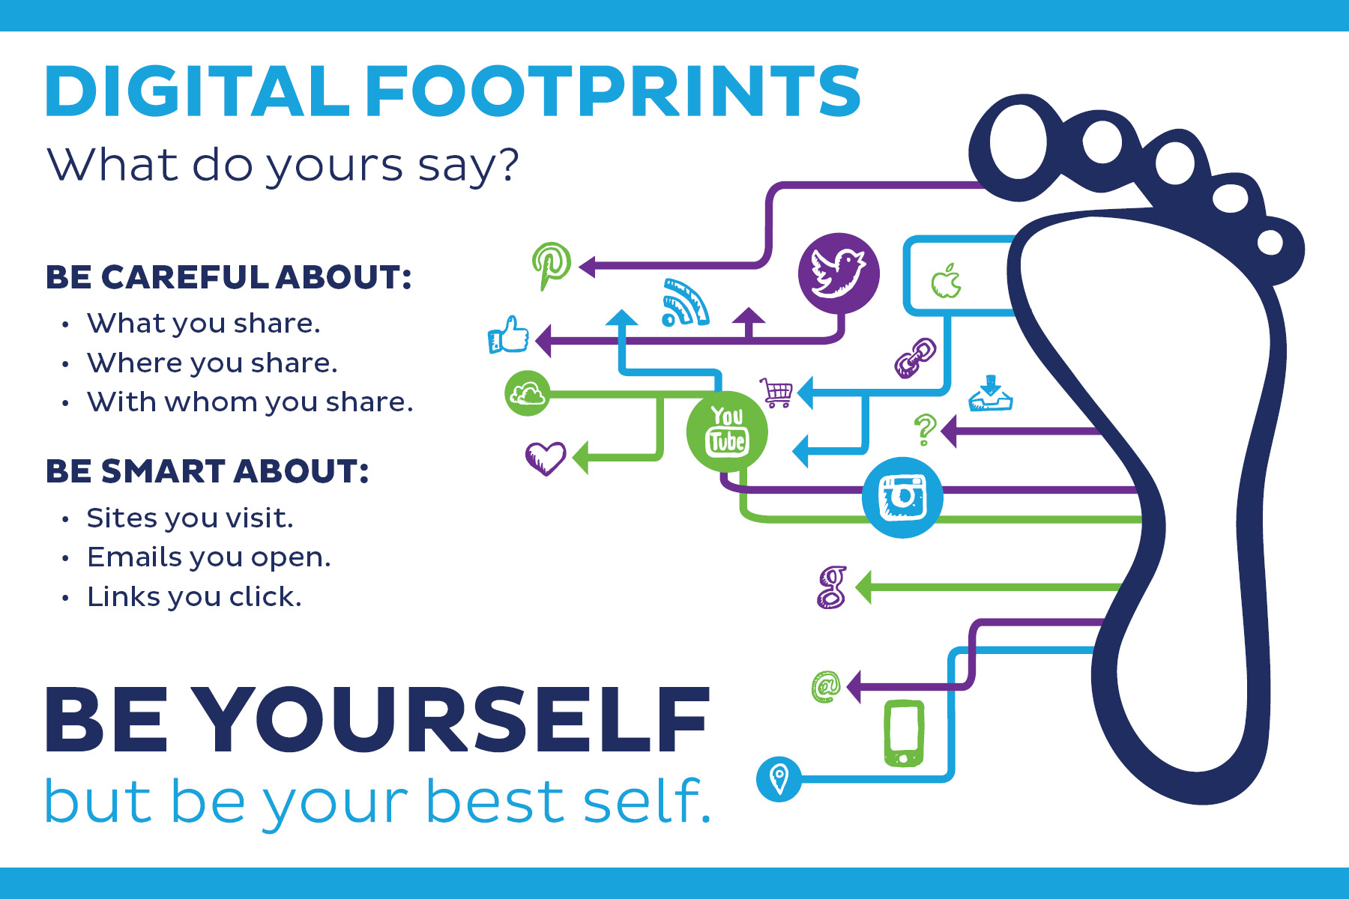
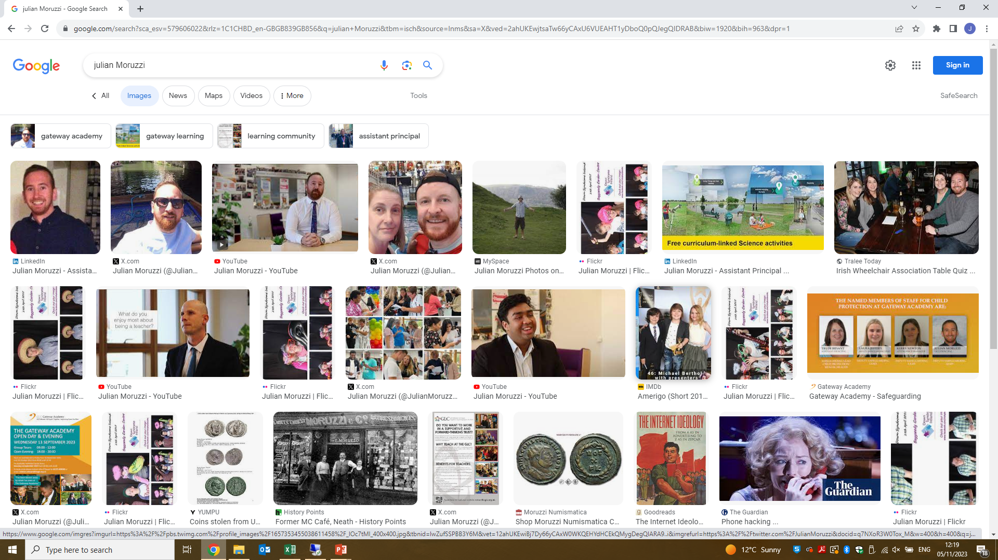

Slide 3
Let’s think about…
What to do if something worries or concerns us
The pros and cons of our lives online
How we can stay safe online
Notes:
Briefly introduce what the assembly is going to cover by clicking to reveal each topic:
The pros and cons of our lives online
How we can stay safe online
What to do if something worries or concerns us

Slide 4
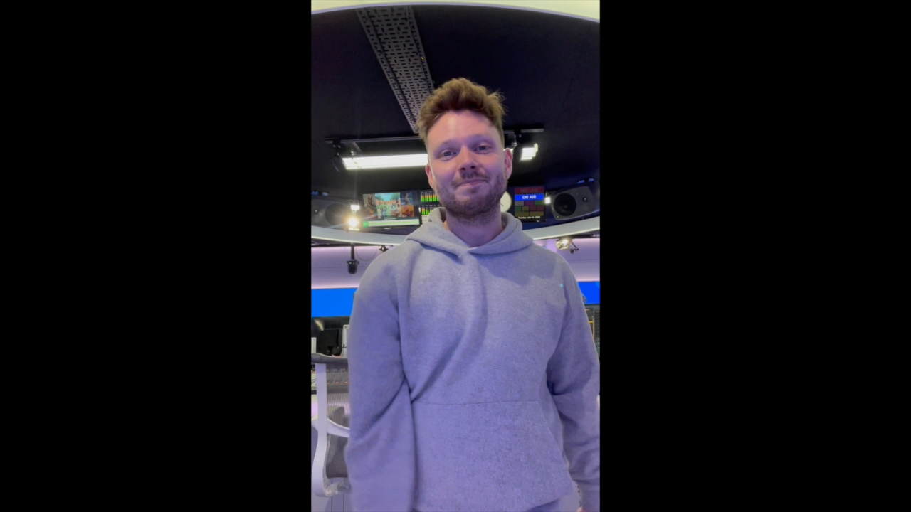
A message from …

Slide 5



What does your online life look like? Journals – write down what it looks like/ what you enjoy and what you get up to.
Notes:
Emphasise that you aren’t here to tell pupils to stay away from the internet – there are so many positives about the online world.
Ask: what does online life look like for pupils? What do they get up to, and what do they enjoy?
Allow a moment for pupils to think about this before moving on.

Slide 6
You may have thought of…
Gaming
(e.g. Roblox)
Streaming (e.g. Twitch)
Social media
(e.g. Instagram, TikTok)
Notes:
Click to reveal the statements one by one.
Explain that these are some of the most common things that people enjoy doing online. You could ask for a show of hands to see who does each of these things.
Elaborate on each point, for example:
Talk about the different games that are available online/you are aware your pupils play, like Roblox or Fortnite
Talk about different forms of streaming service, e.g. watching gaming streams on Twitch, or watching films and TV shows on streaming services like Netflix and Disney+
Talk about different forms of social media, and how they’re used, e.g. sharing pictures and sending DMs on Instagram, filming and watching videos on TikTok, sharing pictures on Snapchat
Emphasise that these are all really fun things to do with friends, and that you’re not trying to put pupils off using the internet for these purposes.
However, pupils must be informed of the potential dangers so they can continue to use these services safely.

Slide 7
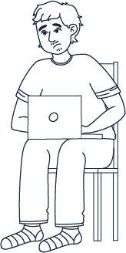
What are the dangers online?
Notes:
Ask: what are the dangers online?
Give pupils a moment to think of what some of the dangers might be.

Slide 8
You may have thought of…
Seeing inappropriate content
Talking to strangers
Lack of privacy
Cyber-bullying
Notes:
Emphasise that this isn’t an entire list of dangers, but some of the most common. Elaborate on each as it appears:
Lack of privacy – are pupils keeping their profiles private, or can anyone see their pictures and videos? If they’re public, anyone can do whatever they want with them, including photoshopping and sharing them across the internet. Your social media may also give away personal details like where you live or where you go to school – this information could be used for stalking or identity theft
Seeing inappropriate content – gaming websites and anything that uses algorithms to suggest content (e.g. Instagram, YouTube) carry a risk of showing content that is inappropriate for under-18s. There are plenty of stories in the news about children coming across games of a sexual nature on Roblox, with no warnings or age restrictions. Algorithms such as the “for you page” on TikTok have also been in the news for presenting children with self-harm and pro-eating disorder content
Cyber-bullying – it’s very easy to say things online that you wouldn’t say to a person in real life. This might include sending bullying WhatsApp messages or DMs on social media, or sharing images of a person without their consent to ridicule or embarrass them
Talking to strangers – it’s easy to start up conversations with strangers online, especially if you’re playing the same games. You may well feel like you’re making friends in these online communities, and someone may suggest meeting up. Remember that people aren’t always who they say they are, and that gaming and other online chat services are a common way for groomers to find young people. Never meet up with anyone who you don’t already know from real life, and never trust the information that strangers give you about themselves
Explain that you’re now going to share some true stories based on these issues.

Slide 9
Zahra’s story
Zahra was in year 11
She had public social media accounts on Instagram, TikTok and Twitter
Her username was her first name and surname
She shared drunken videos and wrote hurtful comments on other people’s posts
She tried to find a weekend job but was turned down because employers Googled her name
Even after making her accounts private, some of her pictures still showed up in Google
Notes:
Share this story, based on a true case:
Zahra was in year 11. She had public social media accounts on Instagram, TikTok and Twitter, all using her real name as her username. She shared videos and pictures online of her getting drunk with friends, and left comments on other people’s posts criticising their appearance – most often things she wouldn’t say to someone’s face. She started looking for weekend jobs but kept being turned down. When she asked for feedback, one job got back to her and told her that they’d searched her name in Google, and found all of her mean comments and inappropriate videos. Even after she made her profiles private, some of the images still came up in Google.

Slide 10
Sam’s story
Sam was in year 8
He loved playing on Roblox and went on nearly every day
While exploring a virtual world, he saw a group of naked avatars
In the chat, players were talking about sexual acts
The game Sam was in didn’t have any age restrictions set and left him feeling very uncomfortable
Notes:
Share this story, based on a true case:
Sam was in year 8 and loved playing on Roblox after school. While exploring a virtual world in the game, he found a group of avatars not wearing any clothes. In the chat, the players were discussing various sexual acts, and some of the avatars were simulating having sex. The game Sam was in did not have any age restrictions set on it, meaning he and children who were even younger were able to come across this content completely by accident. Sam felt very uncomfortable about seeing this, and was worried that he might get into trouble for seeing content he wasn’t old enough to see.

Slide 11
Videk’s story
Videk was in year 10
He had a public Instagram account where he took and shared selfies
At school, he noticed people were laughing and joking about him
Someone had made a fake Instagram account, pretending to be him, and had photoshopped his pictures to embarrass him
Videk reported the Instagram account but a lot of pupils had already saved the photos
Notes:
Share this story, based on a true case:
Videk, a boy in year 10, had a public Instagram account, which included several selfies. At school, he became aware that people were talking about him and laughing. Eventually, one of his classmates showed him another public Instagram account, where people had taken his selfies and photoshopped them in a variety of embarrassing ways. Videk immediately deleted his own Instagram account, but had no power over this fake account that someone else had set up. Ultimately, he’d lost control of his photos by putting them up publicly on Instagram, and now had no power to stop this fake account beyond using Instagram’s reporting tools.

Slide 12
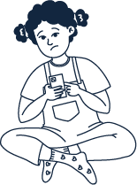
Sonia’s story
Sonia was in year 9
A girl called Nadine (14) and her brother Finn (12) started chatting to her over Instagram DMs
Finn started flirting with Sonia and asked for sexually explicit pictures, which she sent to him
Sonia planned to meet up with Finn and Nadine at the shopping centre, but when Sonia arrived a man was waiting for her
She left immediately and contacted the police
Notes:
Share this story, based on a true case:
Sonia, a girl in year 9, started chatting to “Nadine” and her brother “Finn” over Instagram DMs. Sonia, Nadine and Finn all had similar tastes in music and lived in the same town, and quickly became friendly. Nadine said she was 14, like Sonia, and her brother was 12. Finn started to send flirty messages privately to Sonia, which escalated to asking her to send sexually explicit photos. Sonia thought they were boyfriend and girlfriend at this stage, and shared the pictures willingly. She made plans to meet up with Finn and Nadine at the local shopping centre, but when she got to the meeting point, a man was waiting for her. She quickly left and reported what had happened to the police. The man was later found guilty of multiple counts of grooming and possessing explicit photos of children.

Slide 13




Keep your identity secret – make your online profiles private and only share them with people you know
Report anything upsetting or worrying
How do we stay safe online?
Share what you’re doing online with trusted adults
Always tell an adult if something goes wrong – it’s important to be honest
Notes:
Ask: how do we stay safe online?
Click to reveal the points one by one, using these notes to elaborate:
Keep your identity secret – this can include making any online profiles private and creating usernames that don’t use your real name. Don’t tell people your real name, address, school or any other identifying details
Report anything upsetting or worrying – gaming sites and social media apps all have methods to report upsetting content and block particular users who are harassing you or being abusive in any way. If you see something you feel you shouldn’t have seen, e.g. sexual images, then don’t share these any further, but it is a good idea to take a screengrab of anything upsetting so you can share these with your trusted adults. You can also report online sexual abuse to CEOP (the Child Exploitation and Online Protection Centre)
Tell adults you trust about what you’re doing – share what you get up to with the adults in your life. Talking about your online life is so important – this doesn’t just have to be when something goes wrong!
Be honest if something worries you – adults want to help, and if you do see something upsetting, it’s important not to keep it to yourself. Don’t worry about getting in trouble – telling someone will help make sure that you’re safe

Slide 14
Parents
Other adults in your family
Teachers/ Tutors
Lead Coaches/progress lead
In our school, you can always come and talk to [Ms Newton, Ms Jeffrey, Ms Bryant,]
Who can we talk to if we feel worried?
Notes:
Ask: who can we talk to if we feel worried?
Remind pupils that it’s not just their parents they can talk to if they’re worried.
Any member of staff in school will listen and help if they need to talk, or they could go to another trusted adult within their family.
Remind them that your DSL is always available and talk abut any other procedures in your school (e.g. worry boxes).

Slide 15
Remember …
Do …
Think before you post: only say online what you’d be happy to say in real life
Set your profiles to private so only family and friends can find you
Block and report any content that concerns you
Share what you’re doing online with adults you trust, like your family and teachers
Tell an adult if anything upsets you
Notes:
Recap the main points of the assembly, using the tips on this slide and the next to help you.

Slide 16
Remember …
Don’t…
Believe everything you see
Trust everyone is who they say they are
Give out any personal information (like your name, age or address)
Meet up with anyone you’ve met online
Post anything online that you want to keep private
Notes:
If you have our ’10 ways to stay safe online’ posters displayed, let pupils know where they can find them.

Slide 17



Need to talk?
Come and find
Mrs Bryant, Ms Newton, Ms Jeffrey at any time
Speak to your Lead coach or any member of staff
Report to CEOP
Notes:
Reiterate that there are so many wonderful things about being online, but we must always be safe and alert to potential dangers.
If anything in the assembly has made anyone worry, or if it’s made them feel like they want to talk to an adult, let pupils know that they can talk to your DSL or any member of staff at any time (as well as any additional systems your school has in place).
CEOP (https://www.ceop.police.uk/Safety-Centre/) is a way of reporting online abuse, particularly online sexual abuse, designed for under-18s.

Slide 18
Online Sexual Harassment?
Sexual harassment is a type of sexual abuse which includes any form of unwanted sexual behavior. It can happen anywhere (online or offline) and to anyone, regardless of their age or gender.
Online sexual harassment is unwanted sexual contact that takes place on a digital device, and can include:
Making sexual comments or jokes online or over text messages - this could be through memes or GIFs too
Sharing nudes of another person without their consent
Sending someone nudes they don’t want
Someone pressuring another person to send sexual images or have sexual conversations when they don’t want to
Sending someone pornography without their consent
Sharing sexual rumors about someone online
Taking sexual photos of someone without consent (also known as upskirting)
Threatening to share sexual rumors or photos of someone
Notes:
Reiterate that there are so many wonderful things about being online, but we must always be safe and alert to potential dangers.
If anything in the assembly has made anyone worry, or if it’s made them feel like they want to talk to an adult, let pupils know that they can talk to your DSL or any member of staff at any time (as well as any additional systems your school has in place).
CEOP (https://www.ceop.police.uk/Safety-Centre/) is a way of reporting online abuse, particularly online sexual abuse, designed for under-18s.

Slide 19
Online Sexual Harassment?
Responding to unwanted sexual comments online/offline
Take action if you see or hear about someone you know being targeted online:
Report comments. Social media platforms should not allow sexual harassment in the form of comments, photos and videos. If anything sexual is said to embarrass or hurt a young person, get it removed from the website or app by reporting it.
Speak to an adult. An adult you trust can help to report the incident(s) and stop it from happening again. If it’s happening between young people at school, a teacher should be able to step in and help.
Say something about sexual harassment. When communities, schools and friendship groups don’t speak out about the inappropriate and unwanted sexual comments people make, it can make these issues worse. Challenge sexual harassment by talking to others about how unacceptable these comments are, and how they can make people feel.
The School will take this seriously and will also inform the Police, so please speak up
Notes:
Reiterate that there are so many wonderful things about being online, but we must always be safe and alert to potential dangers.
If anything in the assembly has made anyone worry, or if it’s made them feel like they want to talk to an adult, let pupils know that they can talk to your DSL or any member of staff at any time (as well as any additional systems your school has in place).
CEOP (https://www.ceop.police.uk/Safety-Centre/) is a way of reporting online abuse, particularly online sexual abuse, designed for under-18s.

Slide 20
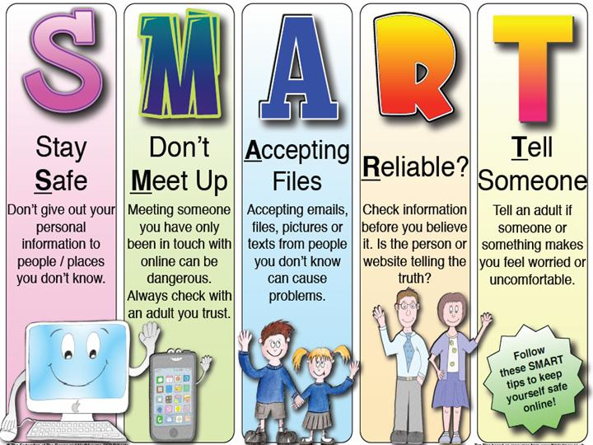
Be SMART on the internet
http://www.kidsmart.org.uk

Slide 21
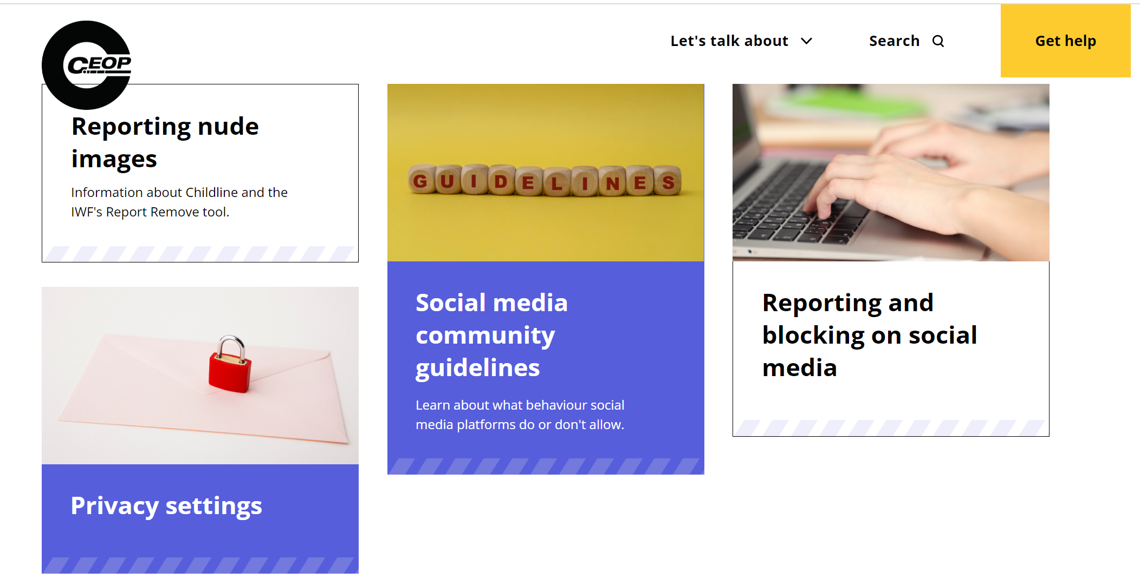
https://www.thinkuknow.co.uk/

Slide 22


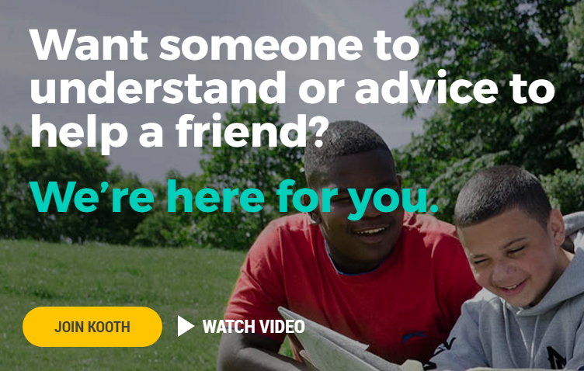
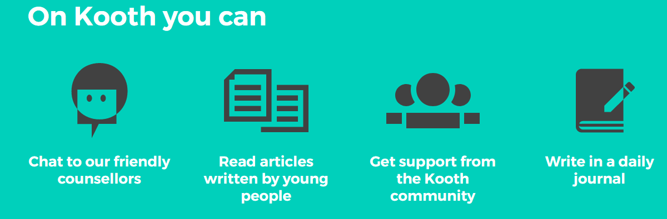
https://kooth.com/

