Slide 1
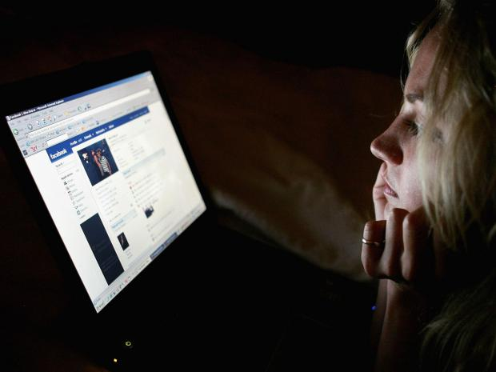
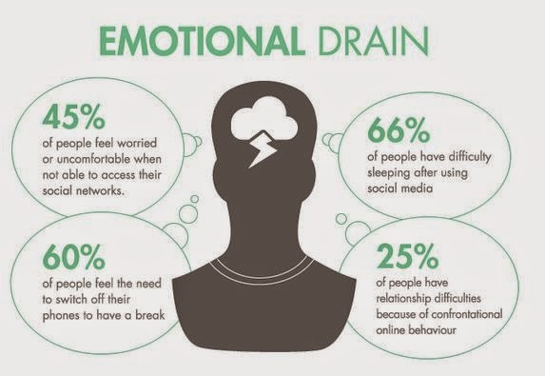

Online Safety
“
The same brain circuits that are activated by eating chocolate and winning money are activated when teenagers see large numbers of “likes” on their own photos or the photos of peers in a social network.
”
https://www.youtube.com/watch?v=eAfyFTzZDMM

Slide 2
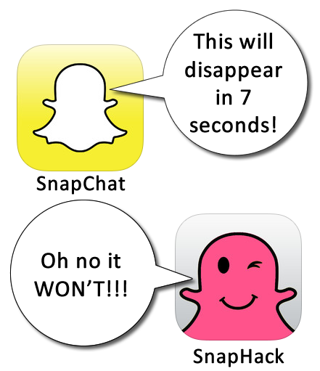
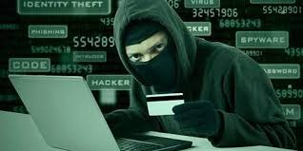

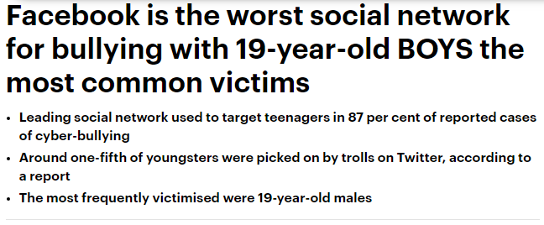

How do these images make you feel?
Quick Survey
How many of you have a SMART phone/ device?
How many of you use Social media?
How many of you use Social media every day?
How many of you talk to more than 5 friends on Social media regularly?
How many of you have a contact on your social media device that you have never met?
How many of you speak to a contact on your social media that you have never met in person?

Slide 3
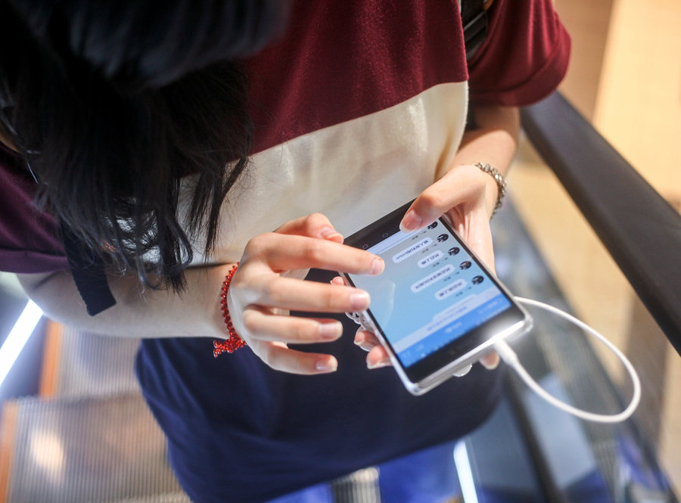
Dangers & Risks - Online
The possibility of something unwelcome or unpleasant happening
Something which causes harm
Exposure to someone or something that causes danger or harm

Slide 4

Top tips to staying safe online
Have a secure password
Be careful what you post online
If you are a victim of cyberbullying, do not answer back
Never open email attachments or click on links from strangers
Watch out for email scams
Beware that even emails from friends can be suspicious
If you get hacked, change your password immediately
Use a firewall, anti-virus programme and anti-spyware programme

Slide 5
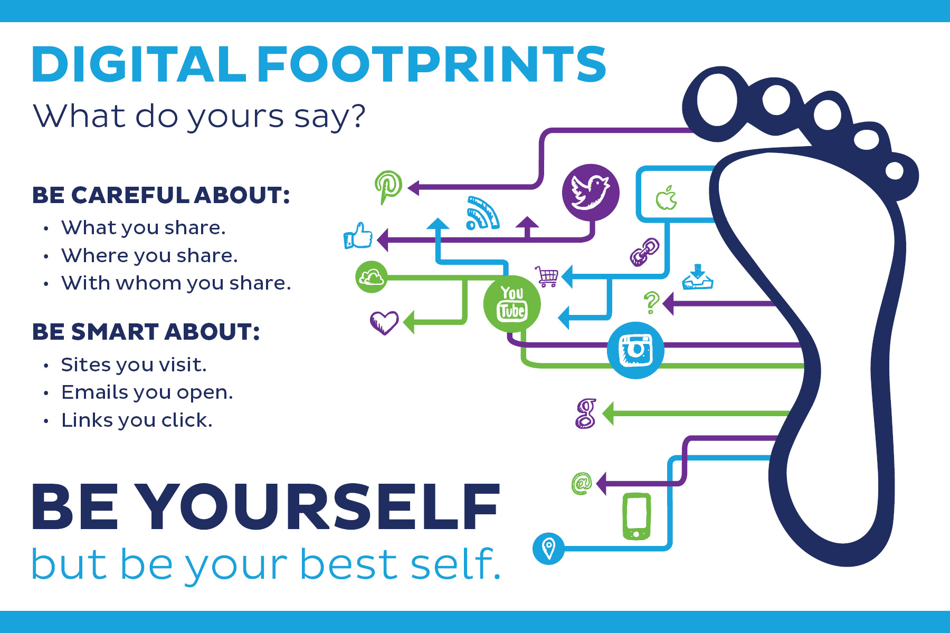
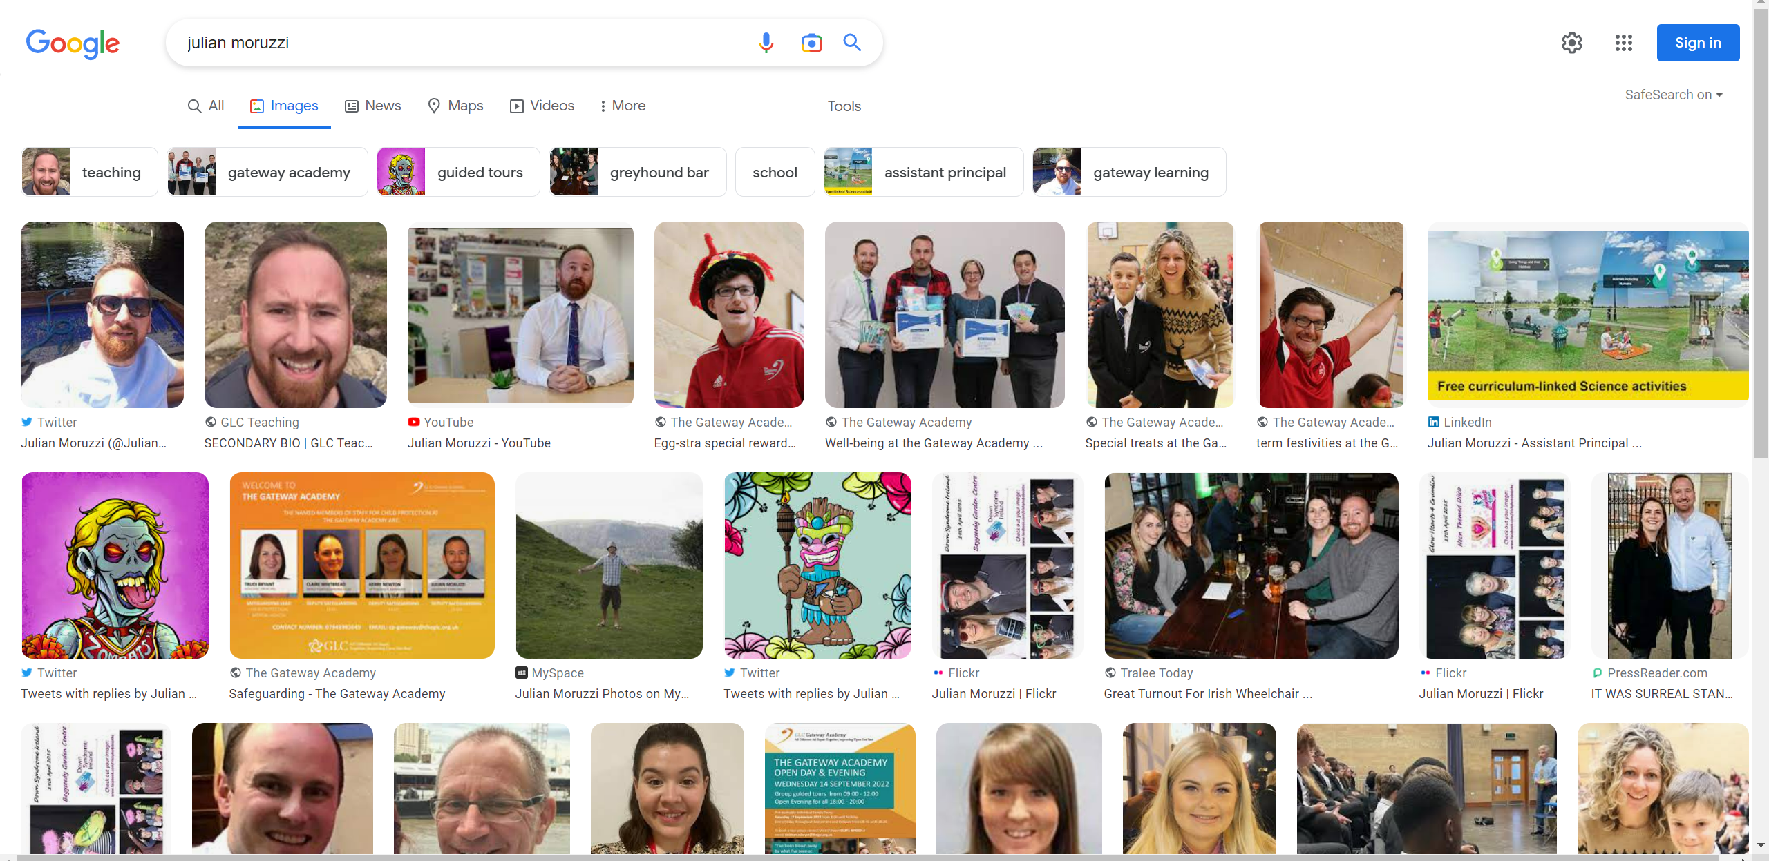

Slide 6
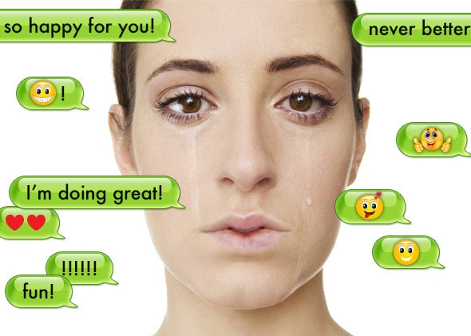

What behaviours & emotions can social media make you display?
How do things on social media impact your life offline?

Slide 7
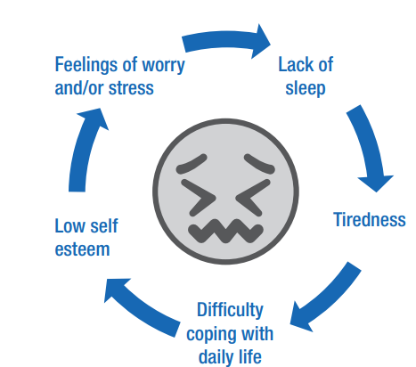
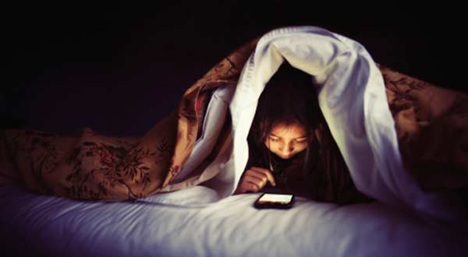
Effects of social media on sleep
Who checks their phone before bed?
Who checks their phone in the middle of the night?
Have you not been able to sleep after checking social media?
Source: Mind

Slide 8
Always be responsible on social media
What you post impacts yourself, people you care about and others.
Content can still be accessed from the site’s servers after it is deleted by the user.
Take screen shots or find another way to record/document the post in order to show it to a trusted person who can help intervene.
Employers, colleges, schools, and the police can monitor your online activity, including private messages
Always think before you post, and report harmful posts appropriately.

Slide 9
Social media & your mental health
“
Young people who spend more than two hours a day on social networking sites are more likely to report psychological distress.
”

Slide 10
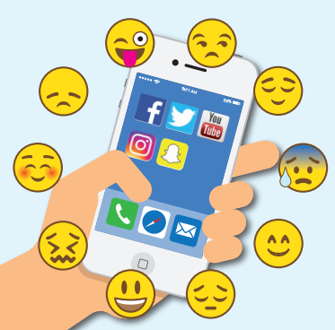
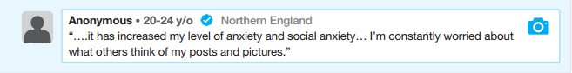
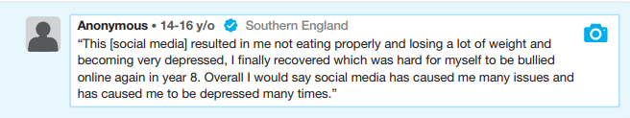
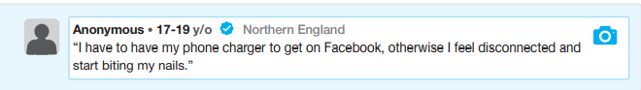
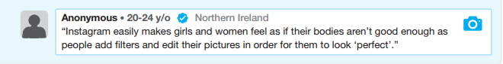
Discuss each of these posts…

Slide 11

SUMMARY - Always be responsible online
What you post impacts yourself, people you care about and others.
Employers, colleges, schools, and the police can monitor your online activity, including private messages.
Content can still be accessed from the site’s servers after it is deleted by the user.
Always think before you post, and report harmful posts appropriately.
Take screen shots or find another way to record/document the post in order to show it to a trusted person who can help intervene.

Slide 12

THINK– do you know anyone or have you ever been a victim of cyberbullying?
A situation in which they felt harassed, bullied, or hurt by the actions or words of another
Nearly 43% of kids have been bullied online. 1 in 4 has had it happen more than once

Slide 13
GROUP TASK:
Cyber bullying vs face-to-face bullying
Face to face bullying | Cyber-bullying
Can find a safe space or escape Limited if onlookers around A bully can be identified Can see facial and body reactions of victim and onlookers | 24 hrs a day No safe place – hard to escape Shared by a wide audience – can go viral in a matter of seconds Bully can be anonymous Harder to empathize with the victim No geographical limitations
Face to face bullying | Cyber bullying

Slide 14

Dealing with cyber-bullying
Saving the evidence of the cyber-bullying
Report threats of harm
Report them to a trusted adult, such as a family member, teacher, or the police
Block their email address, cell phone number, and deleting them from social media contacts
Internet service providers (ISP) have contact email addresses for complaints about email and Cyber Bullying
Don't reply to the email or delete it, get your parents to forward the whole thing to the sender's internet service provider
Don't beat yourself up.
Get help and talk to someone about it

Slide 15
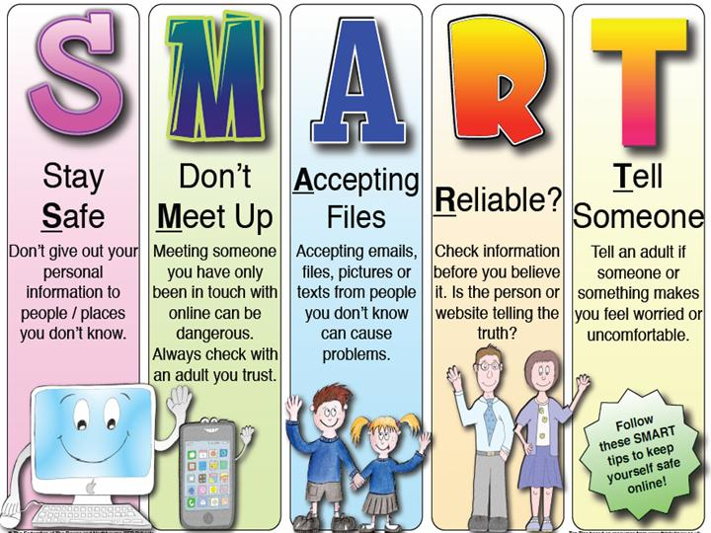
Be SMART on the internet
http://www.kidsmart.org.uk

Slide 16
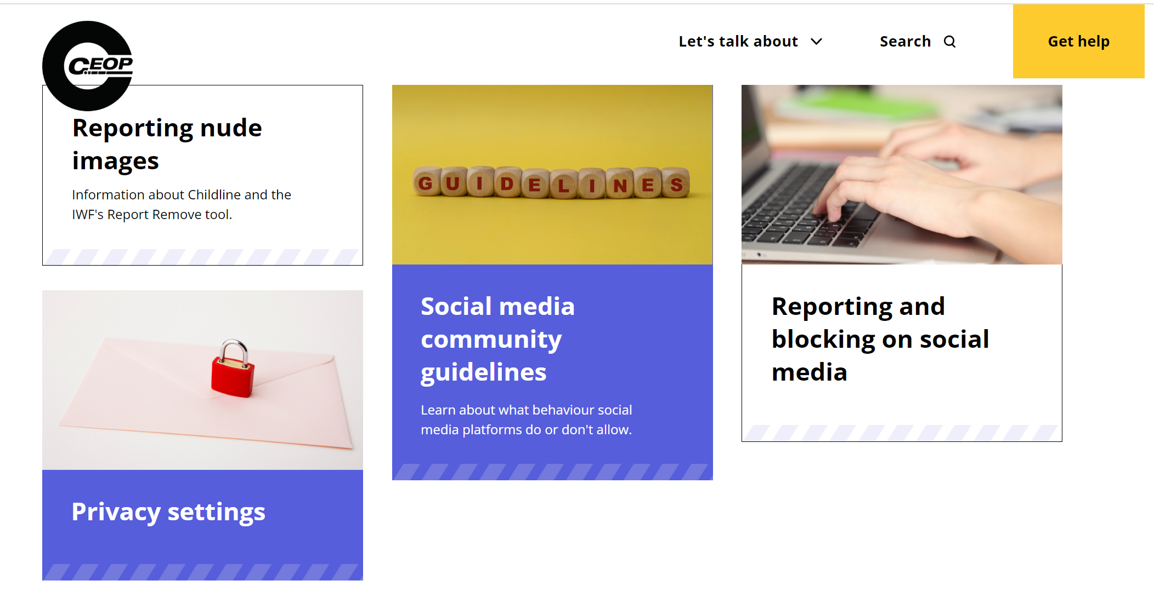
https://www.thinkuknow.co.uk/

Slide 17
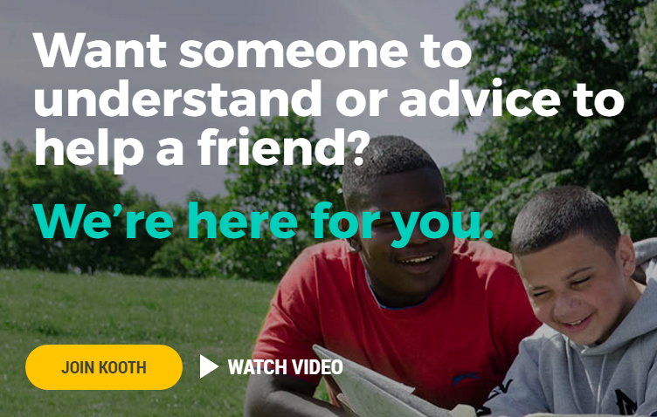

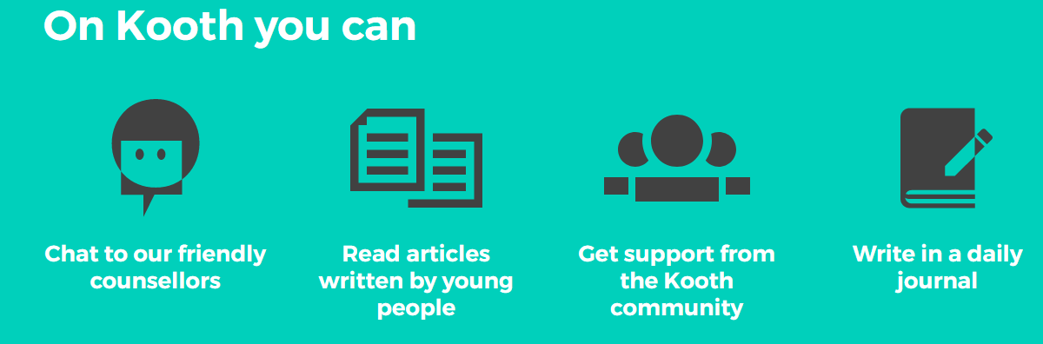
https://kooth.com/

