Slide 1
Google Classroom How to…
Log in
Find Class
Open a task
How to submit work

Slide 2
Your child will require access to the Internet and the browser required is Google Chrome:
Google Chrome - Download the Fast, Secure Browser from Google
2. If anybody else in the family with access to the computer has a Google account make sure they are logged out first

Slide 3
Select Sign In
Sign in using the username and password given to your child back in September:
All usernames follow the same pattern:
Year 7 & 8:
12 followed by STUDENT SURNAME followed by FIRST LETTER OF FIRST NAME followed by @theglc-ict.co.uk
So, pupil named John Smith would be 12smithj@theglc-ict.co.uk
Year 9:
Starts with the number 11
Year 10:
Starts with the number 10
Year 11:
Starts with the number 09
Passwords were given out and children instructed to record them somewhere, they also had the option of changing the password to something more memorable

Slide 4
Find Class
Once your child has logged in successfully return to home screen select the nine black dots in the top right (depending on background the dots might be a different colour but are always here) choose Classroom from options

Slide 5
Find Class
All classes will appear on screen. Find the desired class and click to open it

Slide 6
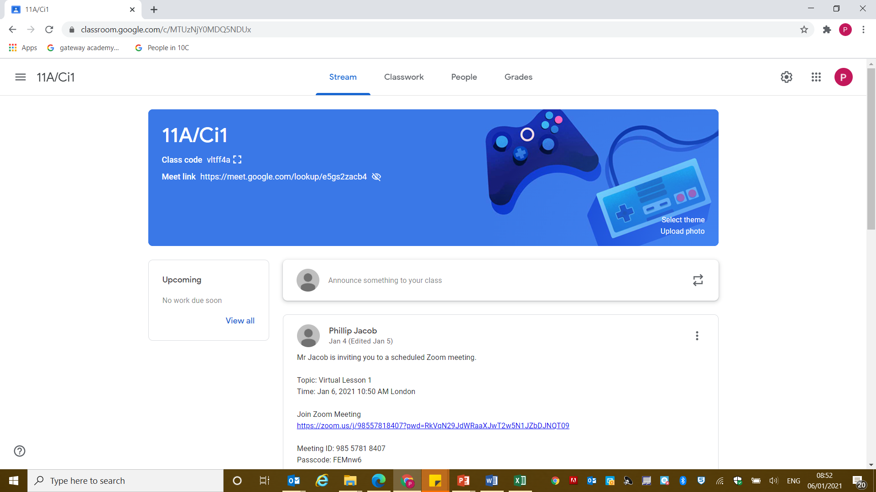
Open and Complete a Task
Once class has been found and opened you will see this screen:
Stream is where teachers will make announcements to your child’s class.

Slide 7
Open and Complete a Task
All lessons and tasks will be under Classwork. The most recent tasks are at the top of the list all previous tasks appear underneath this. Double click on the one you need to do

Slide 8
Open and Complete a Task
Instructions are provided here.
If your child need any files (PowerPoints, worksheets, etc) they will be attached below, just open them as you would any file.

Slide 9
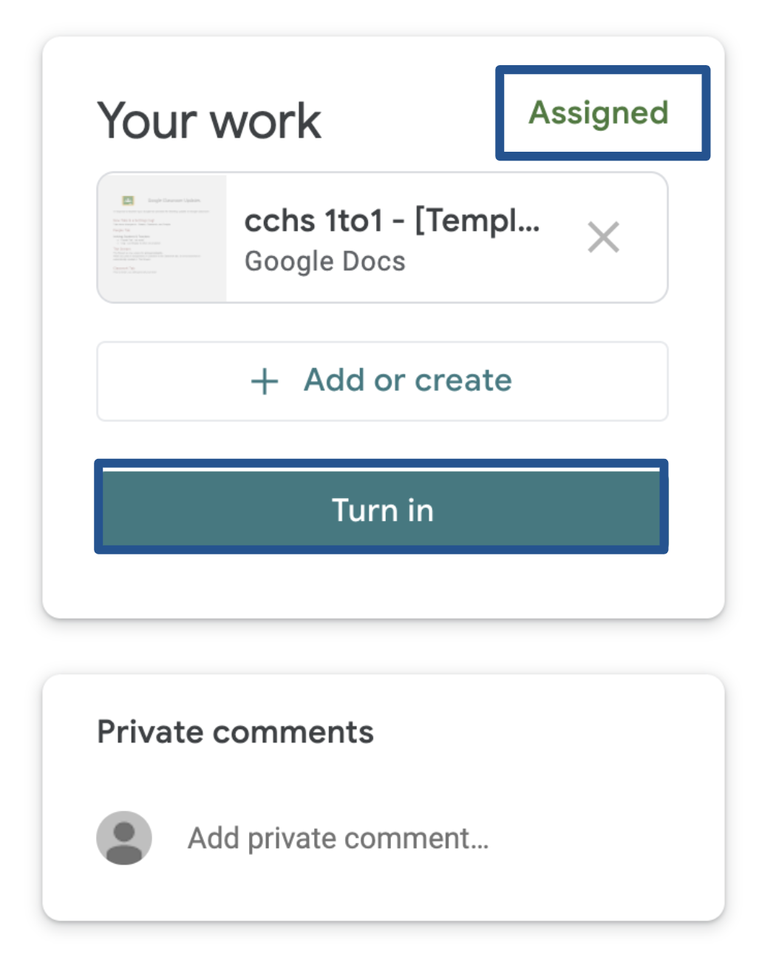
How to Submit Work
When your child completes a task make sure they save the work to their computer as they normally would.
Get them to go into their class on Google Classroom and select their class and then “Classwork” from the options at the top. Then “View the Assignment”
This box should be in the top right.
(It might be a different colour)

Slide 10
How to Submit Work
Select add or create to open the option to attach the work.
When an image of the work appears here click turn in
If your child is working in exercise books or completing their work on mobile phones and/or tablets they should take a photo of books and/or a screenshot of their phone/tablet work. They can then submit these photos/screenshots following the instructions above.

Slide 11
How to Submit Work Upload
When your child clicks “Add or Create work” they will see this screen: They won’t have all the same files as I do (so don’t panic)
Select UPLOAD
Two options here. Either click on upload and then navigate to shared area to find and select saved work. Or open the shared area in a separate screen and drag whatever file you want across (if unsure use the first of these options)

